Slide 1
Course Introduction
CS390: Unix Programming Beth Allen
Office N317
beth.allen@uah.edu
00 - Course Introduction.pptx

Slide 2
Unix/Linux
This course is in UNIX and UNIX Programming
We will learn many features of the operating system as well as how to develop a variety of types of programs using standard UNIX/LINUX features
LINUX is an operating system based on UNIX
There are several variants of LINUX that are popular
The CS laboratory systems are running Ubuntu v14.04.5

Slide 3
What is an Operating System?
The OS is the software that runs on your computer and manages its hardware and provides an environment in which your programs/applications can run.
The OS is loaded into memory when the computer is powered on / booted.
The three most common OS’s for PCs are
Microsoft Windows
Mac OS X
Also derived from unix
Linux

Slide 4
History
UNICS came about in 1969 from the idea of Multics project (Multiplexed Information and Computing Service)
A cooperative project led by MIT, GE and Bell Labs. Bell withdrew from in 1969
System:
Developed on a PDP-7 from Bell Lab
A minicomputer by Digital Equipment Corporation (DEC) in 1965
Cost effective for the time: ~$72,000 (PDP-4 was priced $120,000)
Language:
Written in the PDP-7 assembly language (aka – closest thing to machine language)

Slide 5
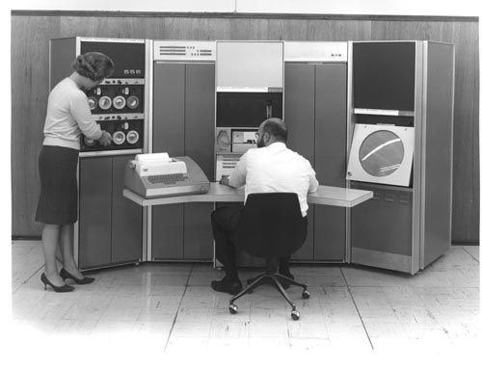
The PDP-7
18 bit word size
144KB of RAM (substantial)
I/O was conducted through a teletypewriter device (TTY)
Instead of a screen, it used a paper feed as display
Image credit: http://archive.computerhistory.org/resources/still-image/DEC/PDP-7/

Slide 6
Unix in C
In 1973, Thompson and Ritchie rewrote UNIX in the C programming language on a PDP-11
Published in the ACM in 1974
“The UNIX Time Share System,” by Dennis M. Ritchie and Ken Thompson, Communications of the ACM, Vol. 17, No. 7, 1974. [Citation link: http://dl.acm.org/citation.cfm?id=361061]
Started as open source
AT&T had been prohibited from entering the computer business
Thompson gave the source away to requests
Many universities contributed, especially Berkley (BSD Unix)

Slide 7
1980s
Sun Microsystems was founded by Bill Joy in 1982
To build dream UNIX machine with built-in networking capability
Not long after the break up of the Bell Monopolies relieved AT&T from the 1958 consent decree which prevented them from turning UNIX into a product.
AT&T promptly rushed to commercialize their UNIX System V
(System V Release 1) released commercial version, combined with different versions of UNIX at that time
AT&T clamped down hard on source-code distribution, licence was expensive ~ $40,000
Contributions from universities began to dry up, no individual could afford the source-code license
Two main distributions of UNIX systems
1980s, UC Berkeley researchers continued to develop BSD UNIX as an alternative to the AT&T UNIX system, later became the other major UNIX distribution, BSD (Berkeley Software Distribution)
BSD 4.2 in 1983 included TCP/IP implementation
1988, AT&T consolidated all the versions of UNIX into SVR4

Slide 8
The GNU Project
Launched in 1984 by the Free Software Foundation in order to develop a complete UNIX-like operating system
Open Source/Free Software
Free to distribute improved versions
GNU/Linux – free UNIX-like OS for x86 system
A GNU/Linux OS is composed of:
A kernel
A set of GNU tools (mimic the original unix tools)
Installation program
Package management system (for installing applications)
Etc.

Slide 9
Popular LINUX Distributions
ubuntu*
redhat
debian
gentoo linux
fedora

Slide 10
CS Computer Lab Tech Hall N328
If you have not already applied, you need to request a CS computer account
Systems in N328:
duchess, dakota, marauder, havoc, invader, catalina, lightning, hawker, conquest, shrike, crusader
You can login remotely with a ssh application
putty ← remote terminal ssh application
filezilla ← secure file transfer
Ex: ssh lightning.cs.uah.edu ← name of each machine when you are outside the local cs network

Slide 11
Commands
Use the command passwd to change your password on the cs systems
Use the command pwd to see your current directory path
Use the command ls to list the files in a directory
Use the command man to get help (manual pages) about command usage
EX: man passwd
Demo login and simple commands

Slide 12
Reading and Self-Study
Read the Paper referenced at the beginning of this presentation
Answer the following:
Briefly describe what you found to be the most interesting topic in the paper.
What technology presented in the paper do you think influenced the operating systems you use today that are not necessarily Unix or Linux?
Compare the memory and file size capacities from the paper to those of the system you work on regularly today.
Compare the cost of the machines mentioned in the paper to the cost of those you work on regularly today.
Review Chapter 1 of the Textbook

Slide 13
- END -

